Slide 1
Other classification of costs
UNIT -4

Slide 2
1. Explicit & Implicit Cost
Explicit Cost:-
Actual money expenses incurred on purchasing and hiring inputs in the production of a commodity are known as explicit costs.
It includes wages paid to the labor, rent of the building, prices of raw material, interest on capital etc.
it is also known as absolute cost or outlay cost or actual cost.

Slide 3
(b) Implicit Costs
These are cost of self – employed or self owned resources
it includes rent of own building , interest on owners own capital, salary for the services of entrepreneur.

Slide 4
2.Money Cost and Real cost
(a)Money cost –
Money Cost is the amount spent in terms of money by a firm for the production and sale of a commodity ( production Cost)
Example – Cost of raw material, interest ,wages, depreciation, rent, publicity, expenses, insurance premium etc.

Slide 5
(b) Real cost –
Real cost refers to the efforts , sacrifices, inconveniences, discomforts and pain involved in supplying the factors of production by their owners.
Real cost is a subjective concept that makes it difficult to calculate.

Slide 6
3.Private cost and social cost
( a ) Private cost -
It refers to cost of production incurred by an individual firm to produce a commodity.
For an individual firm private cost includes both the implicit as well as explicit costs.
(b) Social cost
social cost refers to the cost or disadvantages that the society has to bear on account of production of the commodity.

Slide 7
For instance water pollution, air pollution, noise pollution etc. cause health hazards and there by involves the cost of entire society.

Slide 8
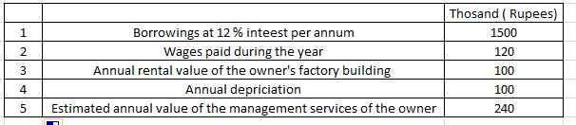
Q.1 Find out (a) Explicit cost (b) implicit cost from the following:

Slide 9
Explicit Cost
Interest on borrowing = 12% of 1500 = 180 Rs
Wages paid = Rs 120
Depriciation = Rs 100
Total = 180+120+100 = 400

Slide 10
(b) Implicit cost
Annual rental value of the owner's factory building = Rs 100
Estimated annual value of the management services of the owner = Rs 240
Total = 100 + 240 = Rs 340

Slide 11

Q.2 Calculate average total Cost and marginal cost for each level of output

Slide 12

We know A.T.C = T.C/Q M.C = Change in T.C/change in output

Slide 13
Q.3 = A firm is producing 10 units . At this level of output, ATC and AVC are respectively equal to Rs 25 and Rs 20. Find out the total fixed cost of the firm.

Slide 14
Ans =
We know ATC = T.C /Q
25 = T.C/10
T.C = Rs 250
AVC = T.V.C/Q
20 = T.V.C/10
T.V.C = Rs200
We know T.C = T.F.C + T.V.C
T.F.C = T.C- T.V.C = 250-200= Rs 50

Slide 15
Q.4 The average cost of 6 units is Rs 5 and average cost of producing 7 units is Rs 6. Calculate the marginal cost of 7th unit.

Slide 16
Ans =
1.ATC = T.C /Q
T.C = 6* 5 = 30
2. Again
ATC = T.C /Q
T.C = 7*6 = 42
M.C = change in total cost / change in output
= 42-30 / 7-6
= Rs 12

Slide 17
Q.5 Suppose the demand and supply curve of commodity X in a perfectly competitive market are given by :
Qd = 200- P
Qs = 10 + P for P ≥20
Qs = 0 for 0≤P<20 ( supply curve of a single firm )
Assume that the market consists of identical firms

Slide 18
What is the significance of P= 20?
At what price will the market for X be in eqilibrium ?
Calculate the equlibrium quantity

Slide 19
Ans =
(1) If P =20
Then the firm will not supply commodity X for any price less than Rs 20
(2) Equilibrium price = Rs 20
(3) Eq. quty.= 200-P = 200-20= Rs 180
Quty. supp. = 10 + P= 10 + 20 = Rs 30
No. of Firms = Eq. Quty. / Quty supp.
= 180/ 30 = 6 Firms

Slide 20
Iso-Quant Curve: Definitions, Assumptions and Properties!
The term Iso-quant or Iso-product is composed of two words, Iso = equal, quant = quantity or product = output.
Thus it means equal quantity or equal product. Different factors are needed to produce a good. These factors may be substituted for one another.

Slide 21
“The Iso-product curves show the different combinations of two resources with which a firm can produce equal amount of product.” Bilas
“Iso-product curve shows the different input combinations that will produce a given output.” Samuelson
ADVERTISEMENTS:

Slide 22
1. Two Factors of Production:
Only two factors are used to produce a commodity.
2 Constant Technique:
Technique of production is constant or is known before hand.
3 Possibility of Technical Substitution:
The substitution between the two factors is technically possible. That is, production function is of ‘variable proportion’ type rather than fixed proportion.
4. Efficient Combinations:
Under the given technique, factors of production can be used with maximum efficiency.

Slide 23
Iso-Product Schedule:
Let us suppose that there are two factor inputs—labour and capital. An Iso-product schedule shows the different combination of these two inputs that yield the same level of output as shown in table 1.

Slide 24
The table 1 shows that the five combinations of labour units and units of capital yield the same level of output, i.e., 200 metres of cloth. Thus, 200 metre cloth can be produced by combining.
(a) 1 units of labour and 15 units of capital
(b) 2 units of labour and 11 units of capital
c) 3 units of labour and 8 units of capital
(d) 4 units of labour and 6 units of capital
(e) 5 units of labour and 5 units of capital

Slide 25
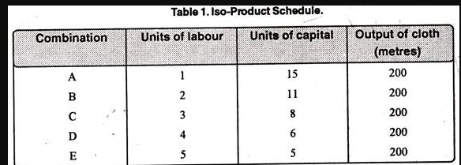

Slide 26
